Slide 1
Carbonyl Photochemical Channels
Double-Hybrid/Triple-ζ Accuracy
Transition States
RRKM Rates
Keiran Rowell - Group meeting update - 24th November 2017

Slide 2
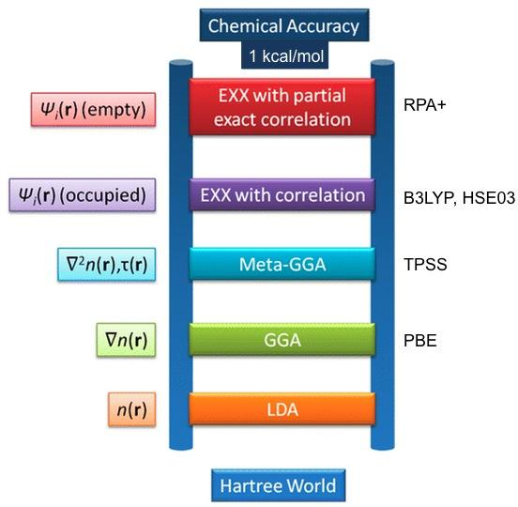
DH-DFT Performance (~4kJ/mol)
Double-Hybrid DFT (DFT + HF + MP2)
RI-B2GP-PLYP/def2-TZVP
Main sources of comparisons:
Experimental G.S. minima² —MAD 0.006 Å (bonds)
Lit. Comp. T.S. structure (CASSCF/6-31G*)³ —MAD 0.003 Å
Miranda’s⁴ M06-2X/6-311++G(3df,2p)//B3LYP/6-31G+(d,p)
Experimental excitation energies⁵
B2GP-PLYP¹ ‘General Purpose’ 0.65 HF : 0.36 MP2
Double-Hybrid
NTI T₁ dissociation barrier heights:
MAD with experimental values: 4.0 kJ/mol
MAD with Miranda’s values: 4.5 kJ/mol
MAD with various literature values: 14.4 kJ/mol
Hybrid: Mixing DFT & HF
Meta-GGA: 2nd derivative
GGA: Gradient of density
S_{0(min)} -> T_{1(min)} (exp⁵.:calc. nm): acetaldehyde 326:316 , acetone 335:336,
propanal 311:311, butanal 304:319 (closer than CCSD(T) or B2K-PLYP)
LDA: Local e⁻ density
B2GP-PLYP/def2-TZVP optimisations in broad agreement w/ experiment and Miranda’s values, without doing single-point
HF and MP2 account for non-local effects not in DFT
DH-DFT should bring accuracy close to composite methods (G3)
DH-DFT/triple-ζ gives best frequencies (~10cm⁻¹) bar CCSD(T)⁶
MP2’s downsides included: need large (triple-ζ) basis-set
MP2 greatly benefits from RI speed-up (x2.5+)
1. A. Karton, A. Tarnopolsky, J.-F. Lamere, G.C. Schatz, J.M.L. Martin, J. Phys. Chem. A, 2008, 112, 12868 2. Ed. R. Johnson III, NIST Computational Chemistry Comparison and Benchmark Database, Rel. 18, 2016 3. M. Kletskii, A. Lisovin, O. Burov, S. Kurbatov, Computational and Theoretical Chemistry, 2014, 1047, 55 4. M. Shaw {PhD thesis] (in preparation), 2017 5. Various literature sources, see ref. 4 6. M. Kesharwani, B. Brauer, J.M.L Martin, J. Phys. Chem. A, 2015, 119, 1701
Jacob’s Ladder Figure: Jinmin Tao’s homepage, http://www.sas.upenn.edu/~jianmint/Research/

Slide 3
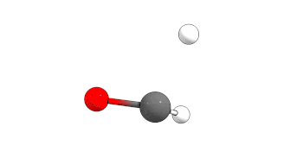
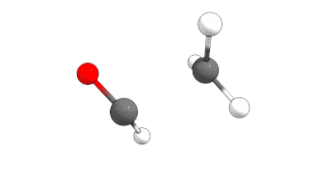
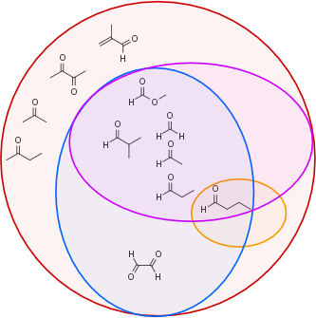
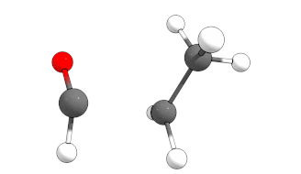
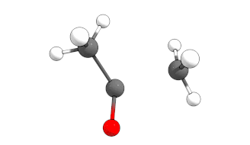
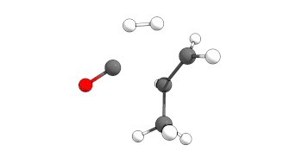
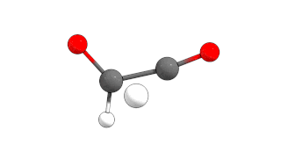
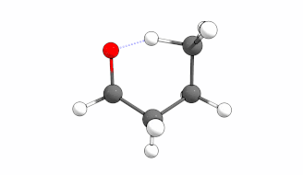
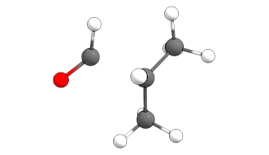
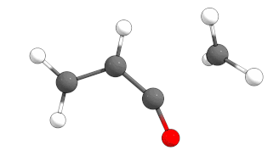
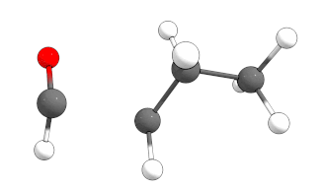
Transition states were located
NTI for 11 molecules. 2 different bond dissociation possibilities (·H/·CH3 or ·HCO/·CH3CO)
2 different electronic surfaces (T₁ or S₁; S₀ is barrierless)
NTII for butanal
S₀ decarbonylation for the aldehydes; 7 molecules
Concerted Triple Fragmentation -> H₂ + alkene + CO; 5 molecules

Slide 4
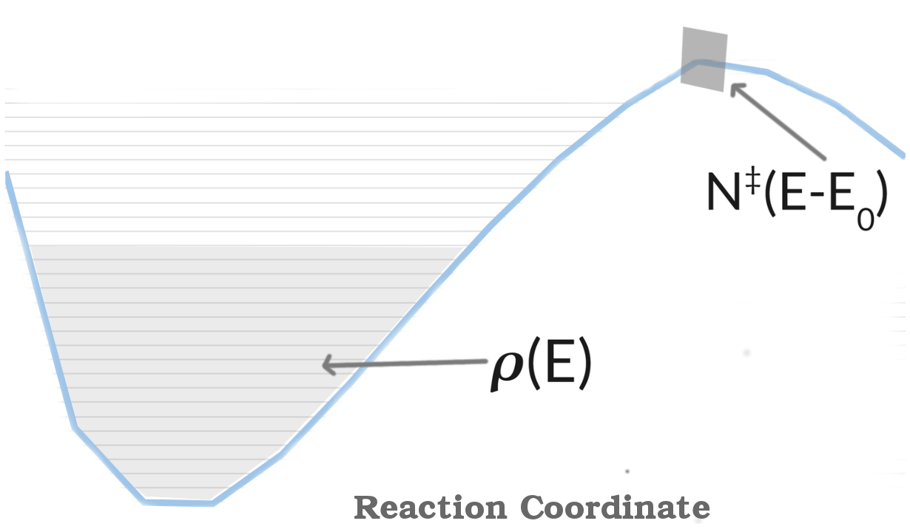
RRKM (theory) — MultiWell implementation
k(E) ∝ N‡(E-E₀) / 𝞺(E)
Calculate N‡(E-E₀) from Beyer-Swinehart direct count (Aaron’s talk)
Sum of states at TS — N‡(E-E₀):
B-S count: Divide energy range into cells (e.g. 10cm⁻¹). Loop through each frequency to see if:
itself, some overtone, or a combination of frequencies are the in the cell. If yes, add to count
Density of states of reactant — 𝞺(E):
Directly from the vibrational frequencies of the minimum. Derivative of B-S count on minima.
Notes:
Find density of vibrational states 𝝆r(Er) and then left over vibration energy is E-Er and the density of vibrational states is 𝝆v(E-Er). Treating the rotations and vibrations as seperate the total rovibronic density of states = integral 𝝆r(Er)𝝆v(E-Er).dEr (any possible rotational state can be combine with any possiblevibrational state). Partition functions come from their classical expressions
Equivalently, the density of states is the derivative of the sum of states with respect to energy

Slide 5
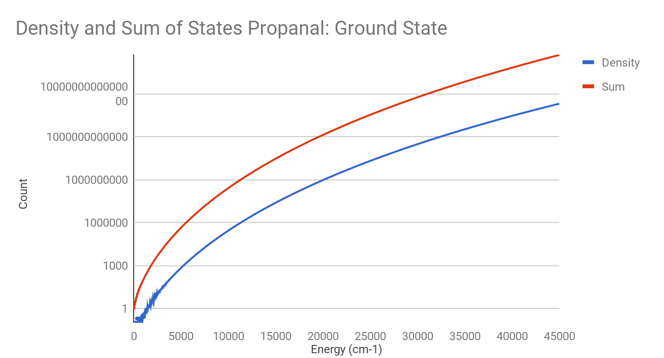
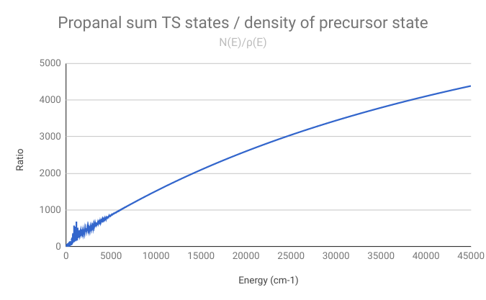
Rate values from RRKM calculations
Wrote a Python Script to do this — harmonic scaling factor¹ 0.9911:
1. M. Kesharwani, B. Brauer, J.M.L Martin, J. Phys. Chem. A, 2015, 119, 1701

Slide 6
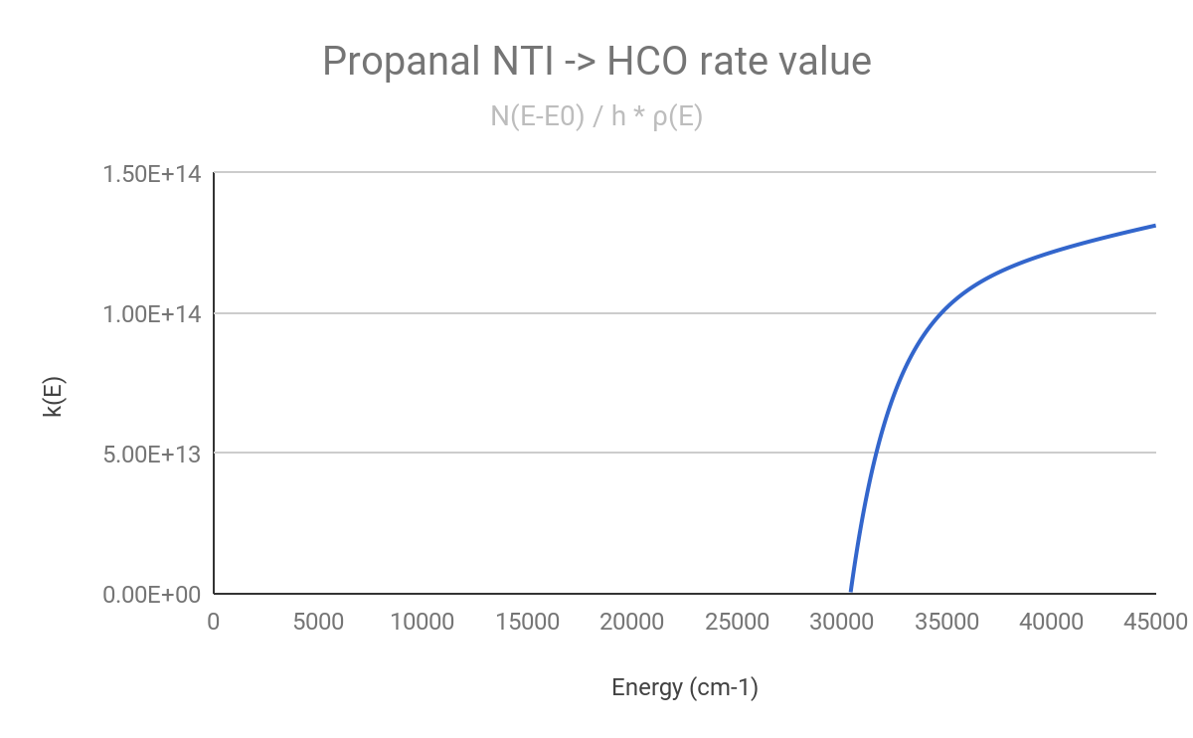
Example k(E) from RRKM

Slide 7
Future directions
Complete set of photochemical channels (fill out matrix)
Larger/more branched carbonyls
Identifying common structural motifs in large biogenic carbonyls
Collisional Energy Transfer (1D minimisations à la Ahren Jasper)
Surface crossing competition in MultiWell (Maggie’s SOC)
Sensitivity analysis (to barrier height, etc.)
Structural photolysis relationships and MCM parameters

Slide 8
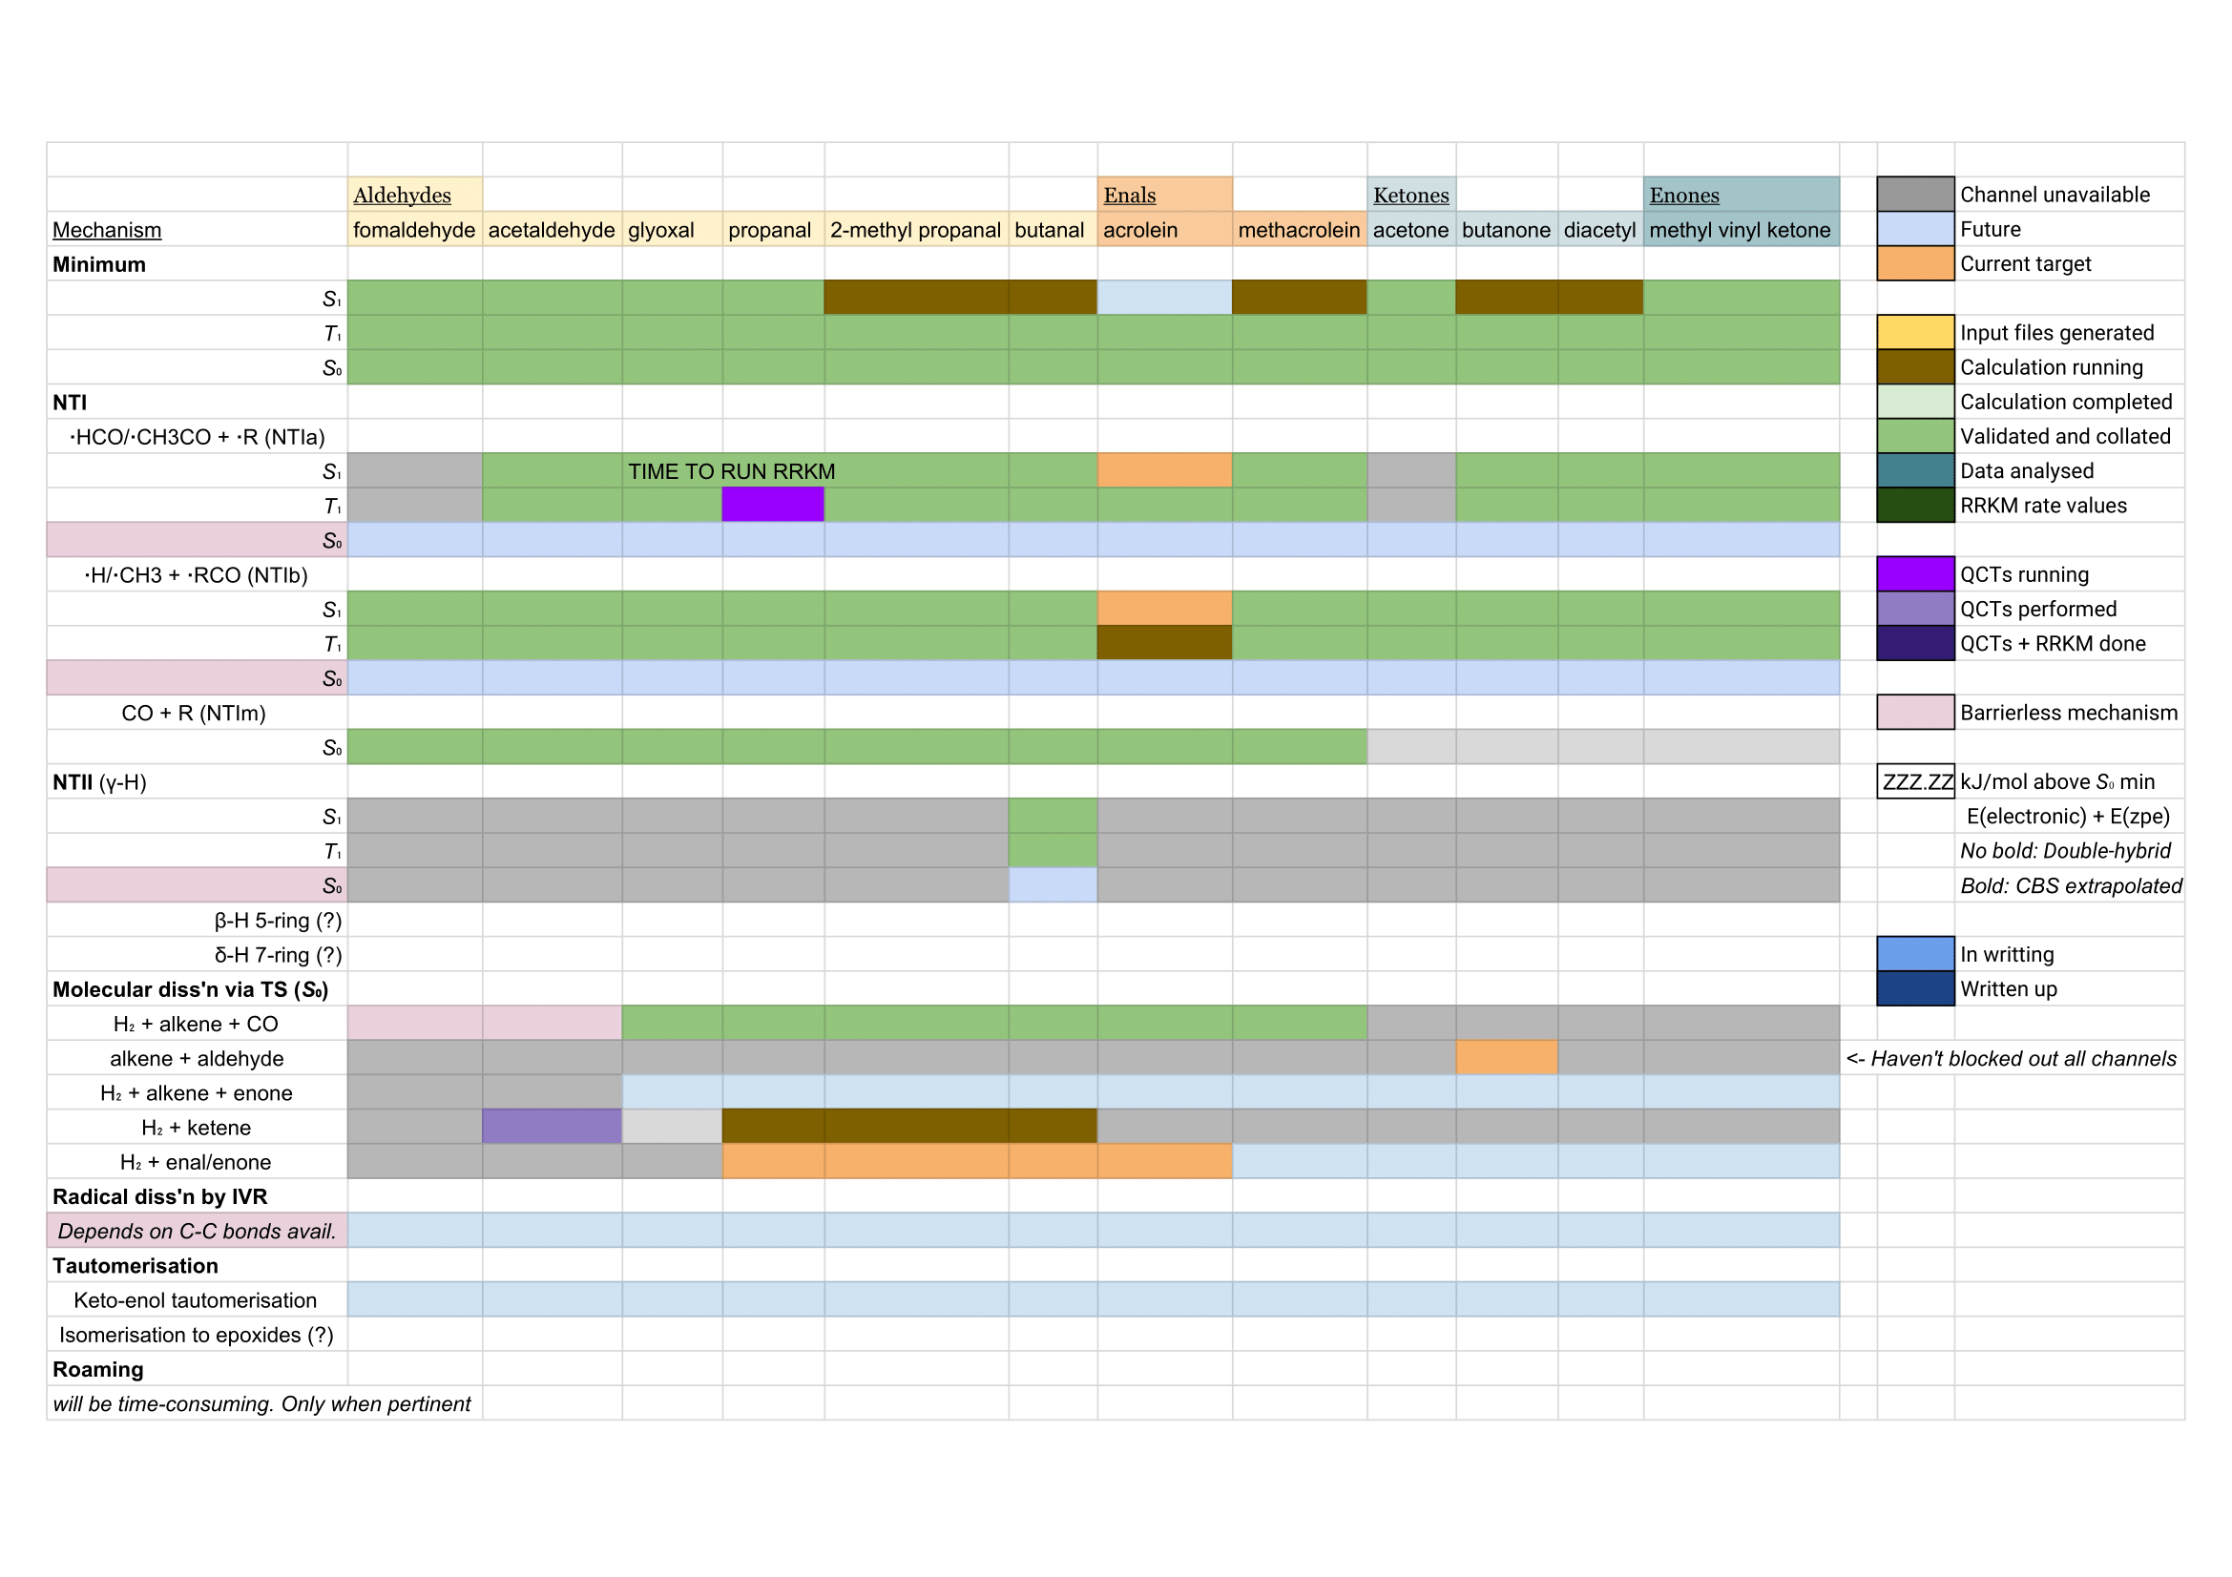
‘Reaction Mechanism Matrix’

Slide 9
Thank you!

